Slide 1
Intro to R
Callum Robins MSc
Email: cjgr1g15@soton.ac.uk
Whatsapp: +447905903155

Slide 2
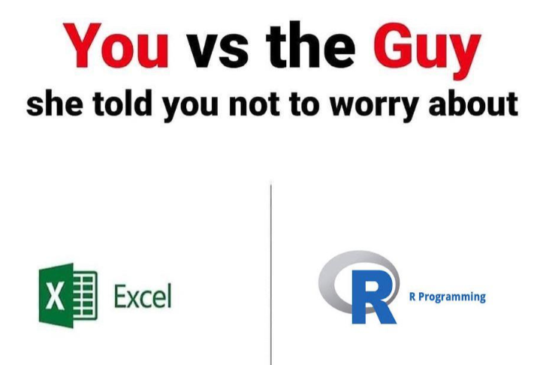
What is R?
Object orientated statistical programming language
OPEN SOURCE!
Related to Python and a direct competitor in Machine Learning
Much more powerful and flexible than expensive competitors, and easier to use for real world stats.

Slide 3
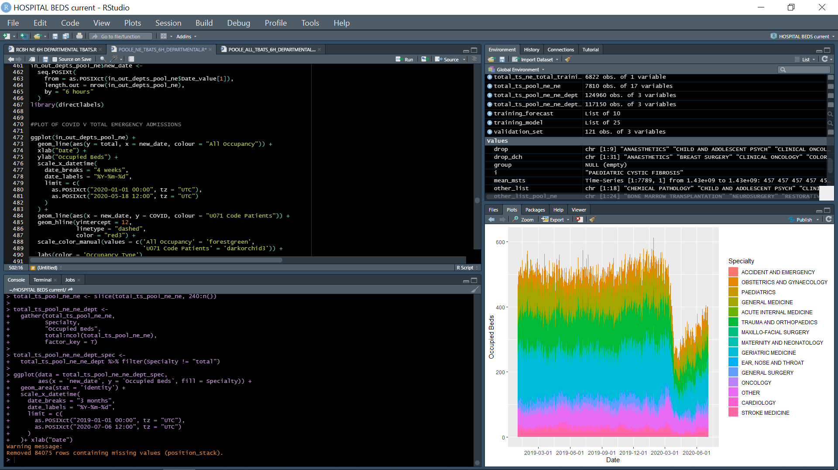

Slide 4
How to work in R Studio
Working in a project environment is personal preference
WD will be set automatically with Project
Packages have to be installed and then loaded for each script
ALWAYS work in scripts rather than console
Ensures your work will be reproducible for validation purposes and you won’t lose track of what’s been done
Ctrl+A then Ctrl+Enter runs your script quickly

Slide 5
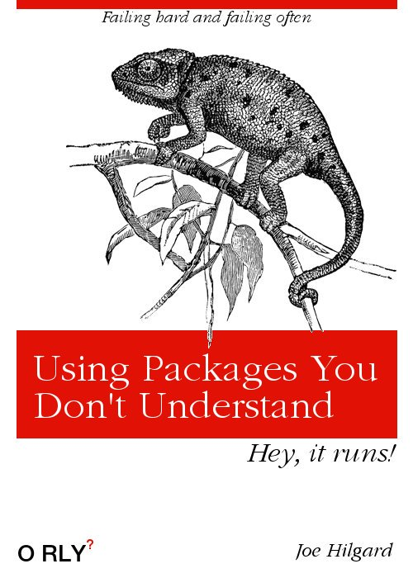
Packages
Tidyverse
Most of the data wrangling and visualisation tools you’ll ever need
Write this in console
install.packages(“tidyverse”)
Lubridate
Deals with funky coded dates and datetime standards
Write this in console
install.packages(“lubridate”)
Then in your script
library(tidyverse)
library(lubridate)

Slide 6
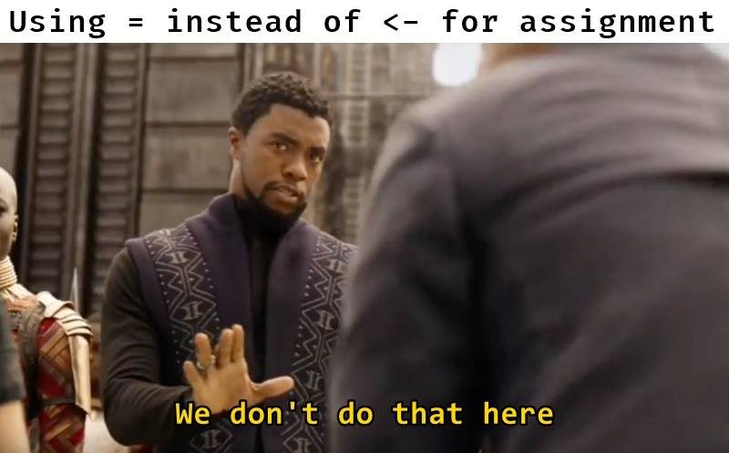
Scalars and Vectors
Main types of data are:
String (character)
Numeric
Integer
Factor
Date
Logical (TRUE/FALSE)
Can be single values (scalar) or lists (vectors) and these can be made in baseR into Matrices
To save values they need to be assigned using the var <- x syntax and x <- c(x1, x2, etc) for vectors

Slide 7
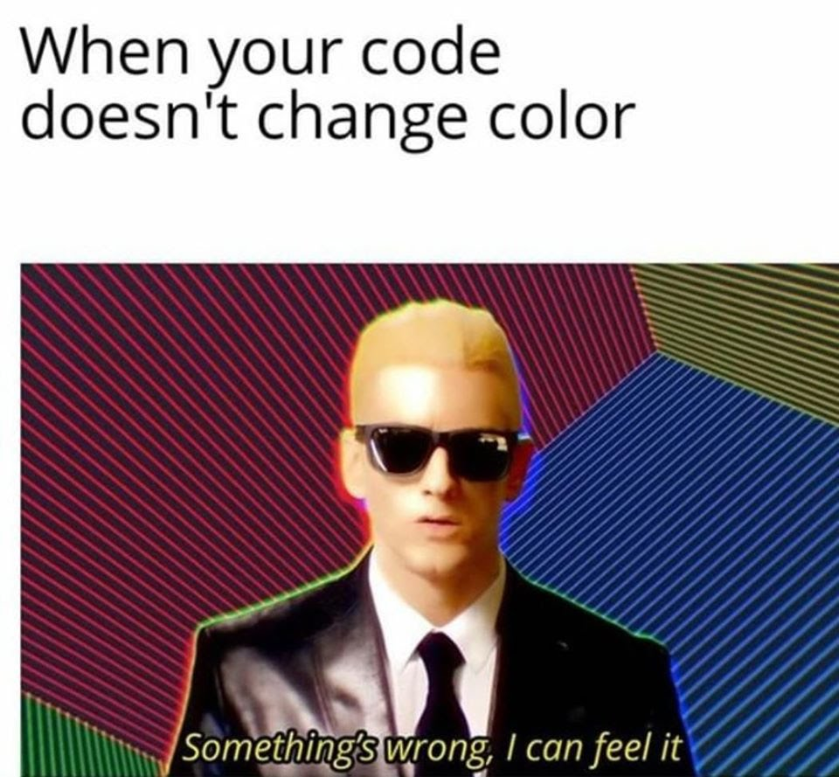
Practice
Make a scalar of 10
Make a bit of code that assigns “Hello_World” to a variable and then prints that variable
Check out the classes of your two scalars now
Reassign them using <- as.integer and as.factor
Make a vector called ten using c(1:10)

Slide 8
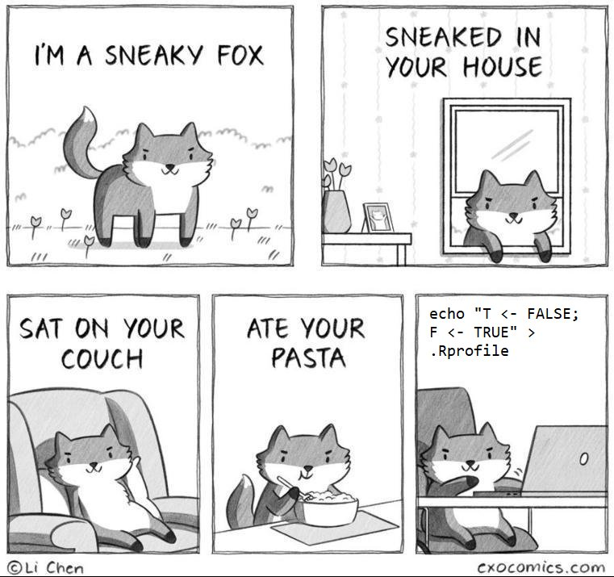
Referring to data and logical operators
Data in objects can be recalled using the specific reference syntax
In a vector the nth value can be recalled using
vector[2]
In a data frame a variable can be referred to using
data_frame$variable
In that variable the nth value can be referred using
data_frame$variable[3]
If you’re using a list of data frames you can use
list[[1]][[2]][1] – it’s more complex
You can test if a scalar or vector is equal to, greater, or less than using the logical operators ==, <, >

Slide 9
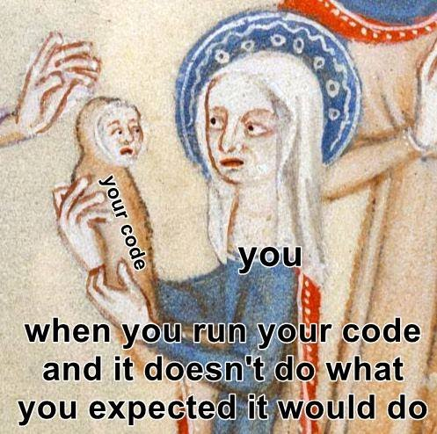
Practice
Bring up the number 3 from your vector ‘ten’
Is it == 3
Is it == 4
Is it > 2
What’s the mean of the numbers 1:10
What’s the SD
Create a sample of numbers using rnorm(number, mean, SD)
Check the SD matches – Why doesn’t it?

Slide 10
Manipulate vectors
As long as the syntax matches you can shift between types of vectors using as.newtype()
You can also explore the length and other properties in the console
You can sort numerical variables using sort()
This is your first introduction to tidyverse functions (stringr)
Str_length(vector) gives the character length of each word(s) in a string.
Str_sort sorts the vector from highest to lowest number of characters

Slide 11

Practice
Create a string variable of all the students in the room using c()
Convert to lower case using tolower()
Convert to upper case using toupper()
How many students are there in the room (using code)
How letters are there in everyone’s first names?
What’s the average length of name in the room
The standard deviation?
Mode?
Median?

Slide 12

Tidyverse and Tibbles
Tibbles are a modern take on data_frames using the tidyverse set of packages
Designed by Hadley Wickham for use in data science.
All the packages share an underlying design grammar, philosophy and data structure.
Tibbles are collections of vectors/variables.

Slide 13
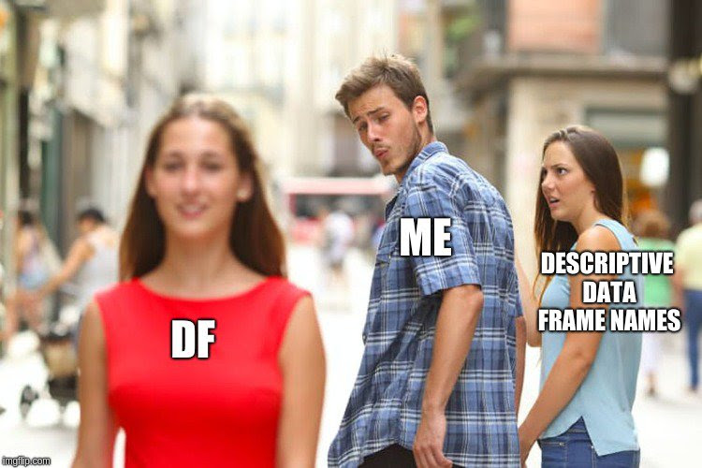
Practice
Copy the code from the email
Use tibble() to create a test_df
Now use tibble to make df for each of the variables matched to ID to simulate drawing data from various sources
In real life this is what will happen with only one variable in common
E.g. Hb_df <- tibble(ID, Hb)

Slide 14
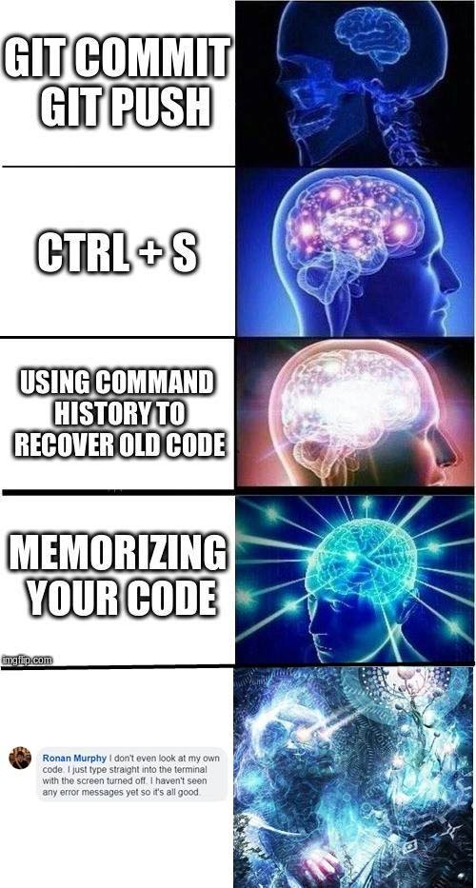
Practice CONT
Now time to use the pipe operator %>%
Create the same test_df and name it same_test_df using the following code:
same_test_df <- list(your_tables) %>% reduce(full_join, by = “ID”)
This joins the multiple tibbles together by their ID number
If you have only 2 df you can use merge() in baseR
Test to see if they’re the same data_frame using the logical operator from earlier
Order the test_df by ID using test_df[order(test_df$ID),]

Slide 15
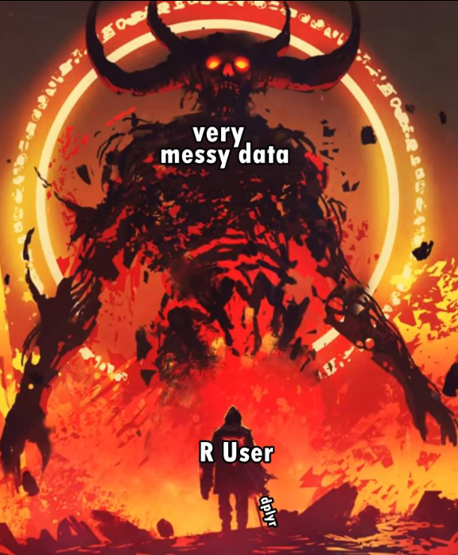
Wrangle a usable dataset
3 key dplyr functions:
mutate
Creates, modifies, and deletes columns. mutate() adds new variables and preserves existing ones; transmute() adds new variables and drops existing ones.
filter
Subsets rows using column values, retaining rows which satisfy the given conditions
group_by
Most data operations are done on groups defined by variables. group_by() takes an existing tbl and converts it into a grouped tbl where operations are performed "by group". ungroup() removes grouping.

Slide 16
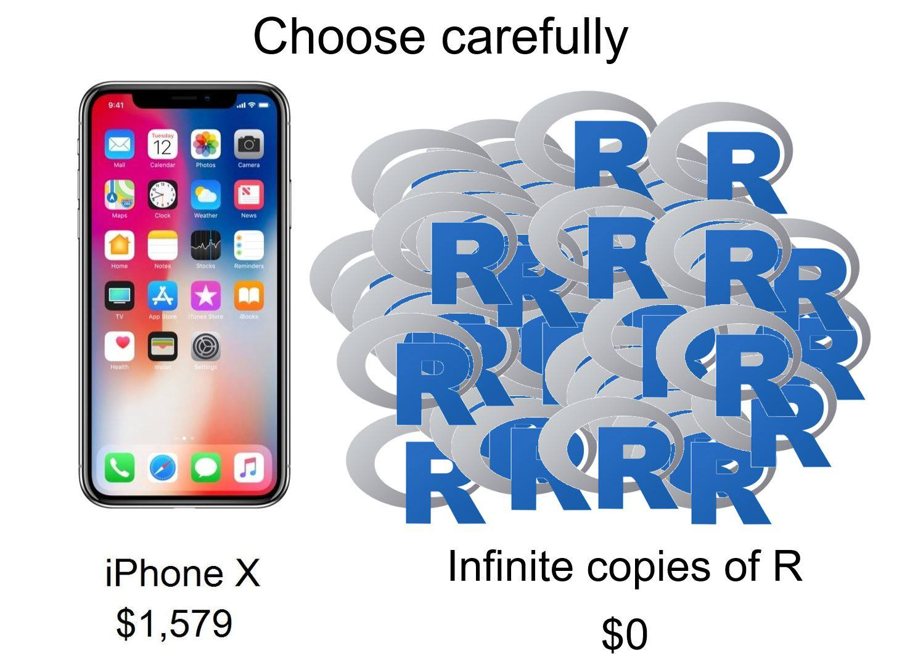
Practice
We’re going old school, Hb is now in g/dL (1/10th of the usual)
Extract a dataset of patients with a Hb under 14 g/dL and group it by ward. You can use the pipe operator multiple times in one bit of code.
Make it look nicer with %>% nest

Slide 17
Functions Used
<-
install.packages
library
c()
print()
[], $, ==, <, >
as.numeric(), as.integer(), as.character(), as.date(), as.POSIXct() etc
rnorm, mean, mode, median, sd, sum
sort()
length()
str_sort()
str_length()
tolower(), toupper()
tibble()
%>%
list()
merge()
reduce()
full_join()
order()
mutate()
filter()
group_by()
nest()

Slide 18


